Slide 1

S.HARIHARAN
Final Project
3/21/2024 Annual Review

Slide 2
CAR PURCHASING AND SALES PRICES WITH RNN
Introduction:
The automotive industry is constantly evolving, with car purchasing and sales prices influenced by a myriad of factors ranging from make and model to mileage, location, and market demand. Predicting these prices accurately is crucial for car buyers, sellers, dealerships, and manufacturers alike. Traditional methods of price estimation often rely on static models that may not capture the dynamic nature of the market.
In recent years, the advent of Artificial Intelligence (AI) and machine learning techniques has revolutionized the way we approach price prediction tasks. Recurrent Neural Networks (RNNs), a class of deep learning models well-suited for sequential data analysis, offer promising avenues for predicting car purchasing and sales prices with greater accuracy and flexibility.
In this project, we aim to harness the power of RNNs to develop a robust predictive model for car purchasing and sales prices. By leveraging historical data on various car attributes and
3/21/2024 Annual Review

Slide 3


AGENDA
Introduction
Importance of accurate price prediction in the automotive market.
Overview of Recurrent Neural Networks (RNN) for predictive modeling.
Understanding the Data
Dataset overview and key features.
Data preprocessing techniques.
Model Architecture
RNN architecture explanation.
Training process overview.
Training the RNN Model
Steps for model training.
Evaluation metrics.
Results and Performance Evaluation
Presentation of results.
Model accuracy assessment.
Application and Future Directions
Potential industry applications.
Future research directions.
3/21/2024 Annual Review

Slide 4

PROBLEM STATEMENT
In the automotive market, accurately predicting car purchasing and sales prices is crucial for both buyers and sellers. However, the dynamics of pricing are influenced by numerous factors, including the make and model of the car, its mileage, year of manufacture, and market trends. Traditional methods of price estimation often lack the precision needed to account for these complexities.
To address this challenge, we propose leveraging Recurrent Neural Networks (RNN) to develop a predictive model capable of accurately forecasting car purchasing and sales prices. By harnessing the power of deep learning, we aim to create a system that can analyze historical data and discern patterns that influence pricing decisions.
Our objective is to train an RNN model using a comprehensive dataset encompassing various attributes of cars, such as make, model, mileage, year, and other relevant factors. Through iterative learning, the model will learn to identify subtle relationships between these features and predict prices with high accuracy.
3/21/2024 Annual Review

Slide 5

PROJECT OVERVIEW
The "Predicting Car Purchasing and Sales Prices with RNN" project aims to develop an advanced predictive model using Recurrent Neural Networks (RNN) to accurately forecast car prices. By leveraging deep learning techniques, this project seeks to revolutionize the automotive market by providing stakeholders with actionable insights into pricing dynamics. Key steps include data collection and preprocessing, designing the RNN architecture, model training and validation, analysis of results, and potential deployment for real-world applications. Ultimately, the project aims to empower both buyers and sellers in the automotive industry with data-driven pricing predictions to optimize transactions.
3/21/2024 Annual Review

Slide 6

WHO ARE THE END USERS?
Car Buyers: Individuals or organizations looking to purchase vehicles can benefit from the RNN-based price predictions to make informed decisions about their purchases. By having access to accurate pricing forecasts, buyers can negotiate better deals and ensure they are paying a fair price for the desired vehicle.
Car Sellers: Dealerships, car manufacturers, and private sellers can utilize the RNN model to determine optimal pricing strategies for their inventory. By understanding the factors influencing car prices, sellers can set competitive prices that attract potential buyers while maximizing profitability.
Financial Institutions: Banks, lending institutions, and insurance companies involved in the financing and insurance of vehicle purchases can use the RNN-based price predictions to assess the value of collateral and mitigate risks associated with lending or insuring cars.
Technology Providers: Companies developing automotive software solutions, such as car pricing platforms or market analysis tools, can integrate the RNN model into their products to enhance their capabilities and provide more accurate pricing information to users
3/21/2024 Annual Review

Slide 7

YOUR SOLUTION AND ITS VALUE PROPOSITION
Our solution for predicting car purchasing and sales prices with RNN offers a groundbreaking approach to revolutionize the automotive market. By harnessing the power of Recurrent Neural Networks (RNN), we provide stakeholders with accurate and actionable insights into pricing dynamics, empowering them to make informed decisions and optimize transactions.
Key Features and Value Proposition:
Accuracy: Our RNN model leverages deep learning techniques to analyze historical data and identify complex patterns influencing car prices. By accurately predicting purchasing and sales prices, our solution enables stakeholders to negotiate better deals and maximize profitability.
Comprehensive Insights: We consider a wide range of factors, including make, model, mileage, year, and market trends, to provide comprehensive insights into pricing dynamics. This holistic approach ensures that stakeholders have a nuanced understanding of pricing decisions.
Real-time Updates: Our solution can be continuously updated with new data, allowing stakeholders to adapt to changing market conditions and make informed decisions in real-time. This agility ensures that pricing strategies remain relevant and effective.
3/21/2024 Annual Review

Slide 8

THE WOW IN YOUR SOLUTION
Input with External Data:
Go beyond traditional car features (make, model, year) and incorporate external factors that influence buying decisions.
This could include:
Economic indicators (interest rates, unemployment)
Gas prices
Consumer sentiment data
Multi-model Ensemble with Explain:
Don't rely solely on RNNs. Combine it with other models like Random Forests or Gradient Boosting Machines for a more robust prediction.
This "ensemble" approach leverages the strengths of different algorithms.
Real-world Application and Societal Impact:
Move beyond a standalone model. Think about how it can be integrated into real-world applications.
This could include:
A pricing tool for car dealerships to optimize their sales strategy.
A platform to help individual buyers determine a fair price for a used car.
A service to track car value depreciation over time.
3/21/2024 Annual Review

Slide 9
MODELLING
Teams cam add wireframes
Wireframe 1: Data Input
Show two sections: Car details and External factors.
Car details capture specifics like make, model, year, mileage, condition.
Wireframe 2: Model Selection & Prediction
Display options for RNN, Random Forest, Gradient Boosting, or an "Ensemble" option that combines all three.
Once a model (or ensemble) is chosen, a button initiates the prediction.
Wireframe 3: Price Prediction with Explanation
Show the predicted price prominently.
Include a section titled "Why this price?" that uses LIME or similar techniques to explain the reasoning behind the prediction.
Wireframe 4: Price Trend Forecasting (Optional)
Include a graph that forecasts price trends over time.
The X-axis could represent time (months, years), and the Y-axis shows the predicted price
Wireframe 5: Real-world Application Integration (Optional)
Mockup a car dealership pricing tool dashboard.
Users can input car details and see the predicted price alongside a suggested selling price.
3/21/2024 Annual Review

Slide 10
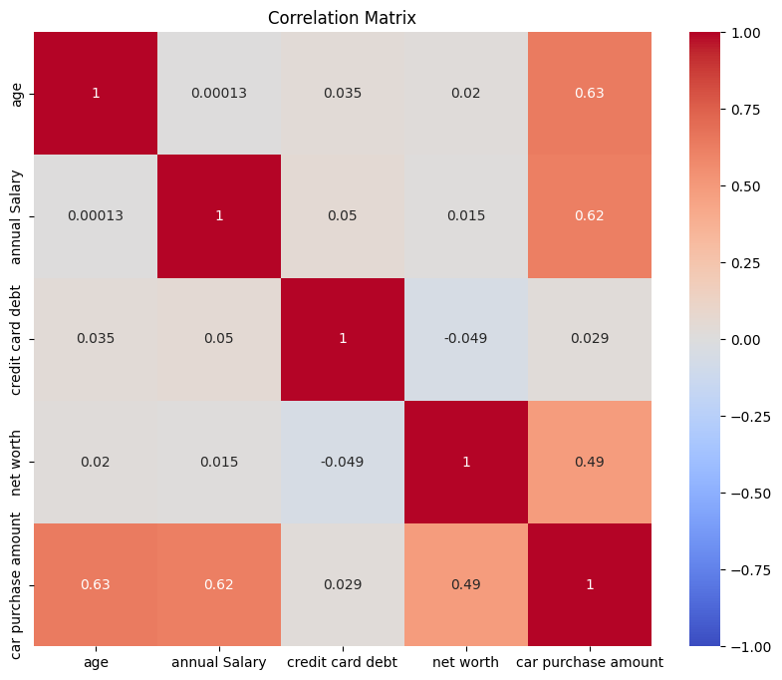
RESULTS
3/21/2024 Annual Review

